Slide 1
IBM University Engagement Project Submission
“Exploring the Power of Machine Learning with IBM Cloud”

Slide 2

Project Tile – [Smart Business Idea Generator Agent]
Domain of Project – [Agentic AI]
Student Name | Recent Passport Photo | Email ID | Mobile number [WhatsApp]
KARTHIKEYAN A S |  | askarthikeyan18@gmail | 8825577893

Slide 3
Problem Statement: Smart Business Idea Generator Agent
The Challenge
In the digital era, innovation is crucial, but individuals, students, researchers, and organizations often struggle with idea generation. Brainstorming sessions are unstructured, inspiration is scattered across articles, videos, and social media, and existing tools focus on text-only prompts without context-awareness. The challenge is not just to suggest random ideas but to synthesize creativity, context, and relevance into intelligent, actionable ideas for diverse domains such as startups, research, content creation, or product development.
The Objective
Build an agentic AI Smart Idea Generator that empowers users with contextual, innovative, and multimodal ideation. The solution should:
Fuse Knowledge Sources: Pull insights from articles, research papers, trend analysis, and social platforms to generate contextual and current ideas.
Enable Multimodal Brainstorming: Accept inputs like text prompts, images (e.g., product sketches), or voice notes and refine them into structured, creative suggestions.
Create a Predictive & Agentic Layer: Identify trending domains (e.g., AI in healthcare, sustainable energy), forecast idea relevance, and recommend high-impact directions.
Visualize Idea Maps: Provide an interactive dashboard that organizes ideas into categories, impact scores, and feasibility maps, helping users explore and refine concepts quickly.

Slide 4
Proposed Solution -
Multimodal Engine: Fuses text, market context, voice notes, and sketches into a unified generation context.
Watsonx.ai Agentic Layer: Uses IBM Watsonx.ai and Granite to steer ideas by tone, focus, and a 1–10 creativity scale.
IBM BOB (Business Optimization Brain): Integrates an offline dataset for continuous analytics, benchmarking, and predictive scoring optimization.
Predictive Dashboard: Automatically maps evaluated ideas onto an interactive quadrant scatter plot (Impact vs. Feasibility).
Refinement Chat: Retains session memory for conversational follow-ups, allowing users to combine or pivot concepts.
IBM Cloud Infrastructure: Built on a secure Flask framework, fully containerized for deployment on IBM Cloud Code Engine.

Slide 5
Technology Used -
Backend & Framework: Python, Flask, Werkzeug, and Python-dotenv.
AI & Cloud Layer: IBM Watsonx.ai SDK, IBM Granite (Granite-13b-insruct-v2), IBM Cloud (Code Engine), and IBM BOB.
Audio Processing: SpeechRecognition and Pydub.
Frontend & Charts: HTML/CSS (Jinja2 Templates) and Chart.js quadrant visualization.
Production Servers: Waitress and Gunicorn WSGI engines

Slide 6
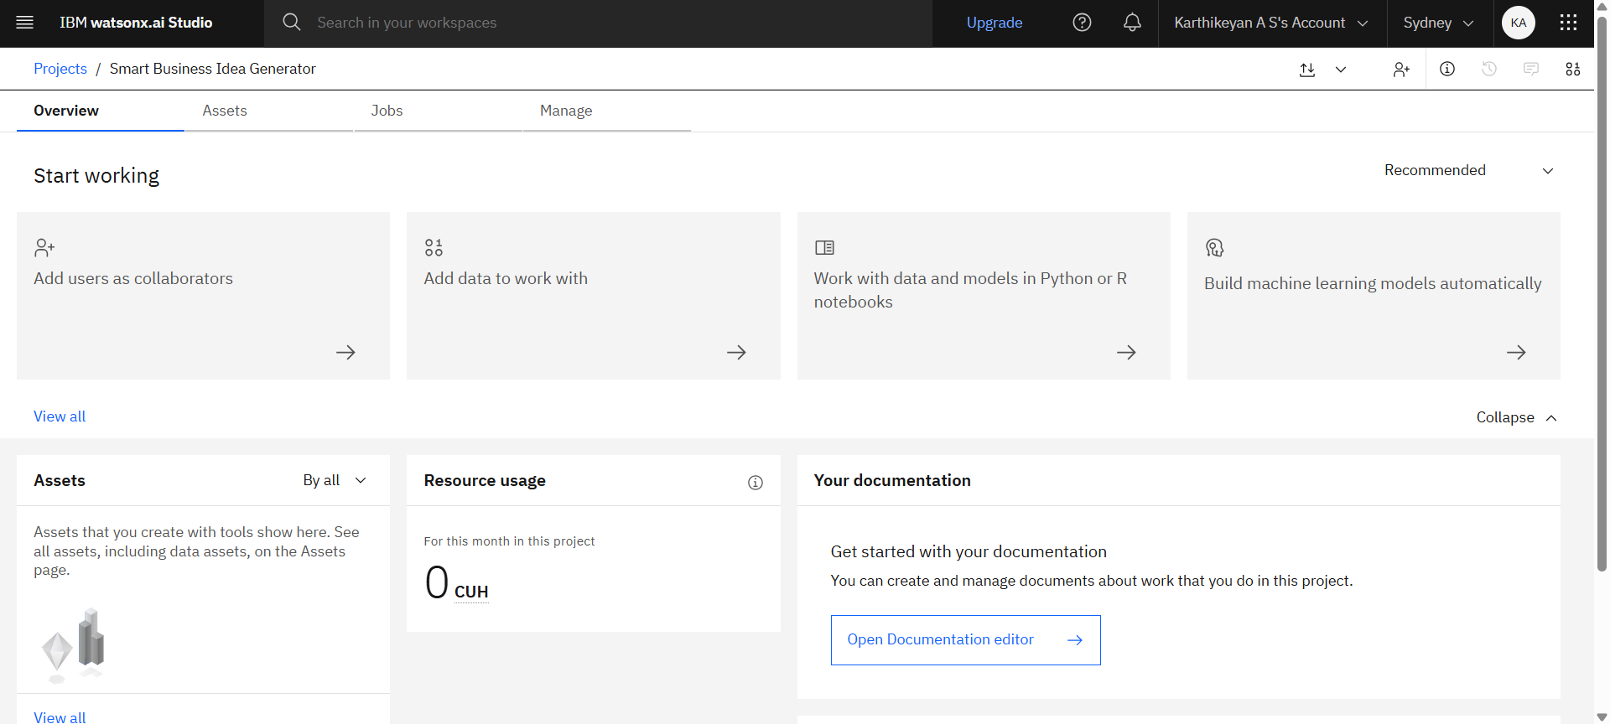
Home page of IBM cloud

Slide 7
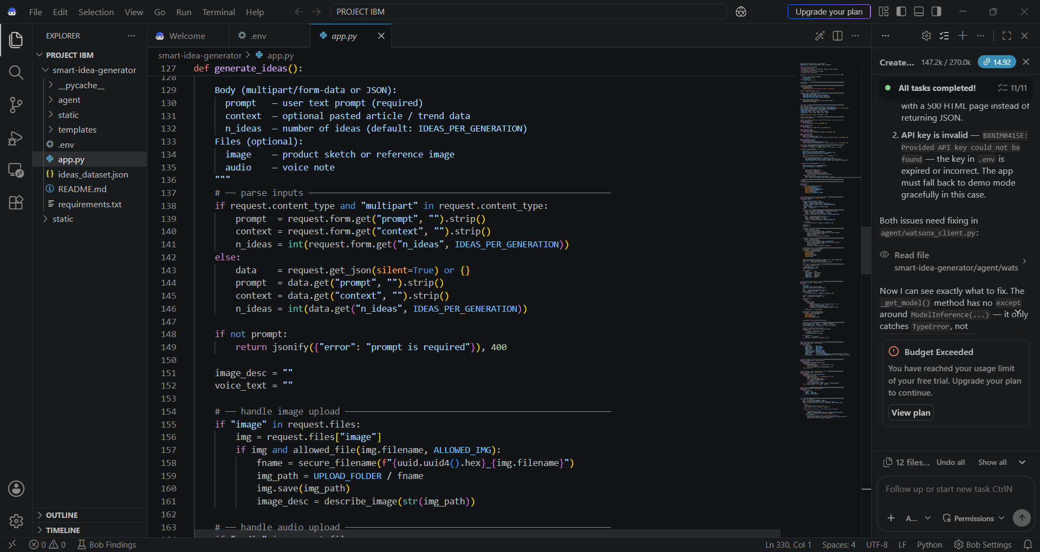
Coding Part of IBM Bob

Slide 8
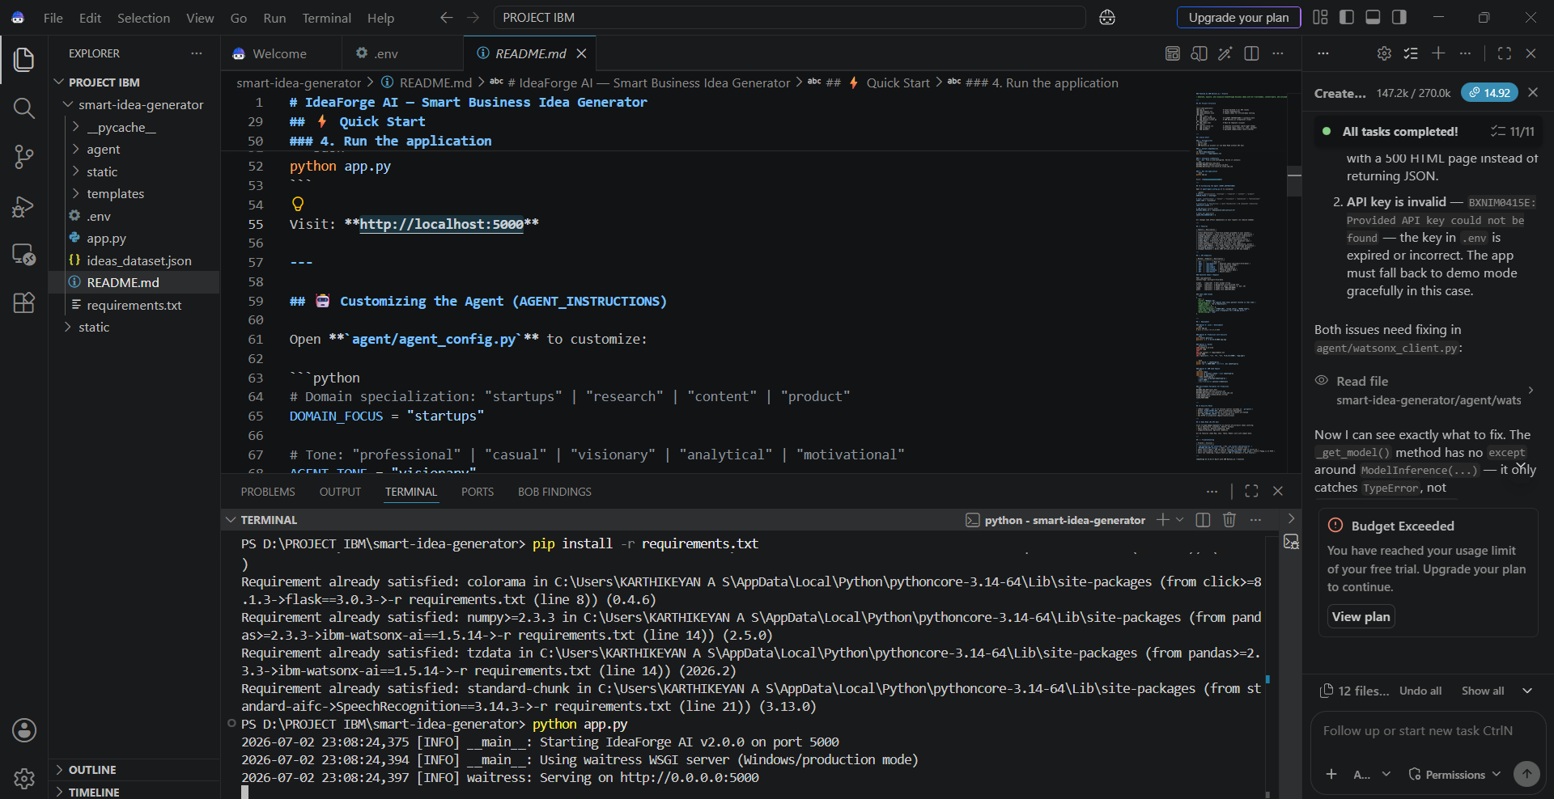
Local host of IBM Bob

Slide 9
Novelty and Uniqueness
Cross-Domain Knowledge Fusion: Merges text prompts, unstructured pasted trend data, speech notes, and rough sketches simultaneously into a singular context layer for target ideation.
Dynamic Parameterized Alignment: Allows real-time programmatic tuning over the agent's tone, focus domain, and a 1–10 creativity scale, balancing highly structured feasibility with market-disrupting concepts.
IBM BOB Automated Orchestration: Integrates a distinct engineering layer (IBM BOB) for backend validation, real-time analytics benchmarking, and evaluation optimization against pre-modeled market domains.
Predictive Metric Mapping: Instantly structures raw AI responses into standard JSON matrices, calculating explicit impact and feasibility indices visualized on an interactive quadrant dashboard.

Slide 10
Git Hub Link
LINK- https://github.com/Cyberoot-20/ibm-internship-project
·
·
·

Slide 11
Future Scope
Advanced Computer Vision Processing: Upgrading from filename-based descriptions to fully integrated multimodal visual processing, allowing the model to interpret visual elements inside product sketches, flowcharts, and structural diagrams directly.
Live Web Data Scraping: Implementing a dynamic context-gathering scraper to ingest trending topics from real-time global news feeds, academic papers, and social platforms automatically into the prompt pipeline.
Automated Mockup Generation: Extending the generation layer to automatically turn chosen business ideas into functional wireframes or code mockups using specialized design LLMs.
Advanced Predictive Scoring Models: Expanding the IBM BOB analytics layer to run deeper predictive financial risk simulations and market saturation calculations before scoring concepts.
Multi-Agent Collaborative Brainstorming: Creating a multi-agent framework where specialized AI personas (e.g., an AI CFO, an AI Marketer, and an AI Developer) debate and refine ideas collaboratively before delivering them to the user dashboard.
·
·
·

Slide 12
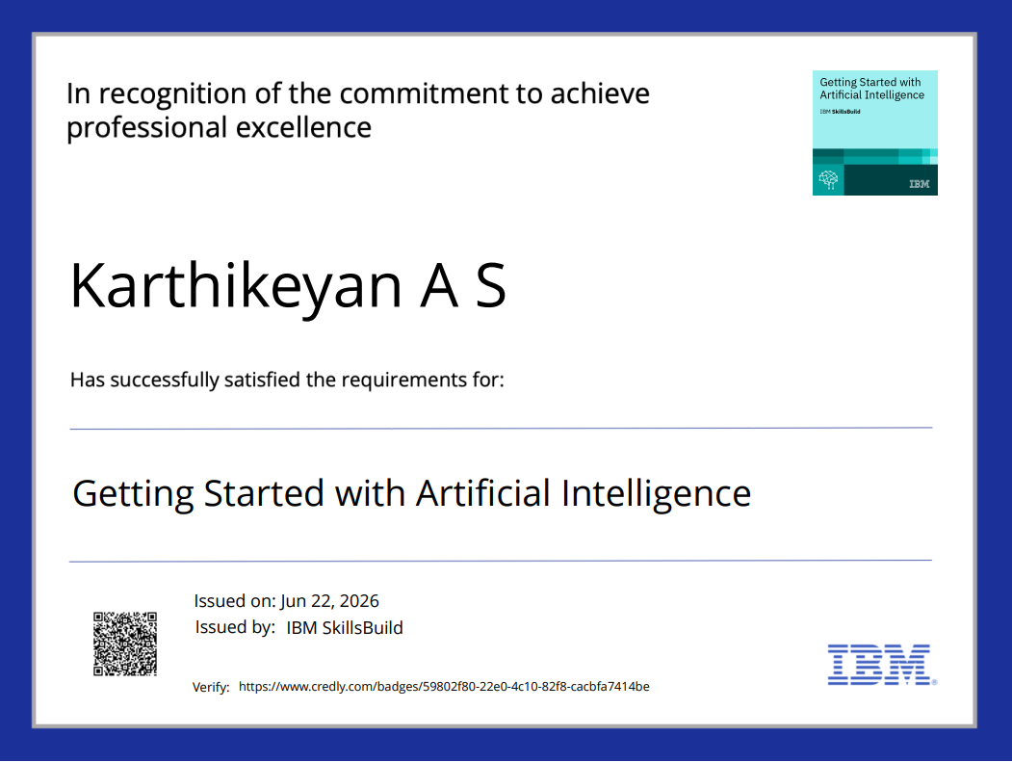
Certificates Earned:
Please add your credly certificate

Slide 13
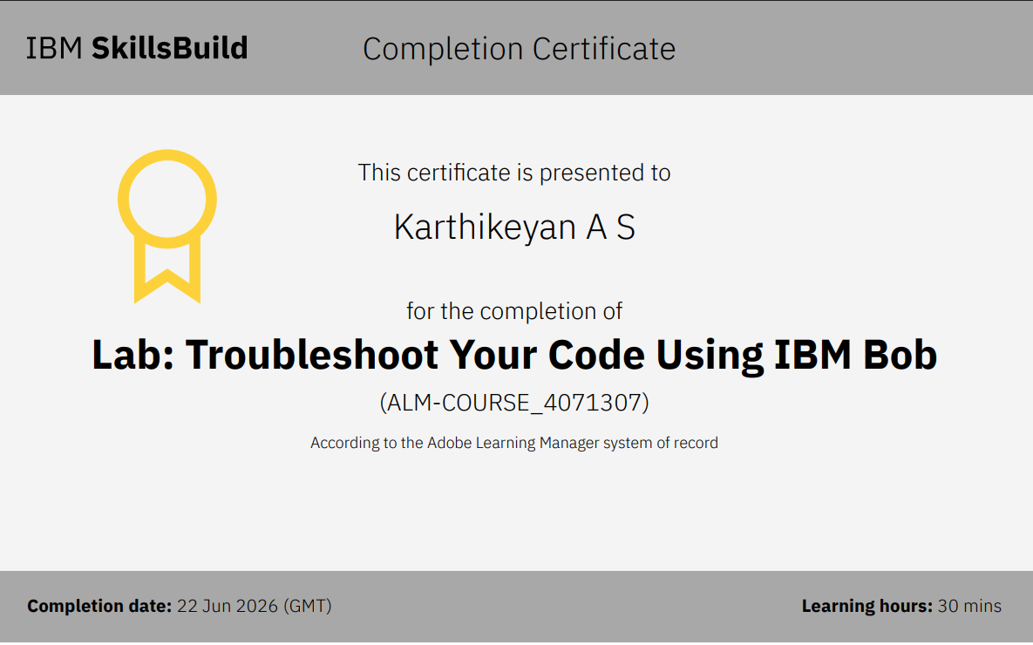
Certificates Earned:​
Add your IBM BOB Certificate

Slide 14


